Slide 1
Schedules 2
Helmich
Helmich, Faustus, Toma, Turčan, Malý

Slide 2
Core features
Everyone
Users – Student, Teacher, Manager, Scheduling committee
Create subjects (Teacher)
Approve Subject (Manager)
Define time and space requirements (Teacher)
Display graphical interface for scheduling subjects and save changes (Scheduling committee)
View schedules (Student)

Slide 3
Create subjects (Teacher)
Toma, Turčan
As a teacher, I need to create a subject and define information about it (name, syllabus, description...), so managers can decide whether the subject is sufficiently useful.
Responsibilities
Authentication and authorization
Content validation and management
Notifications and workflow
User interaction

Slide 4
Approve Subject (Manager)
Helmich
As a manager, I need to approve a subject proposed by a teacher, so the teacher can define time options and the Scheduling committee can schedule the subject.
Responsibility Breakdown:
Authentication and authorization
Approval processing
Notifications and workflow
Storage and audit

Slide 5
Define time and space requirements (Teacher)
Toma, Turčan
As a teacher, I need to define the time and space requirements of a subject, so that the scheduling committee can schedule it.
Responsibility Breakdown:
Authentication and authorization
Inputs and validation
Availability and collisions
Storage and audit

Slide 6
Display graphical interface for scheduling subjects and save changes (Scheduling committee)
Helmich
As a Scheduling committee, I need to view a graphical interface for scheduling subjects, so I can schedule a subject and users can view schedules.
Responsibility Breakdown:
Authentication and authorization
Data retrieval and selection
Interactive planning
Storage and audit

Slide 7
View schedules (Student)
Malý
As a student, I need to clearly display a weekly schedule so I can plan my days.
Responsibility Breakdown:
Authentication and authorization
Data retrieval and selection
Presentation
Error and exception handling
User interaction and export

Slide 8
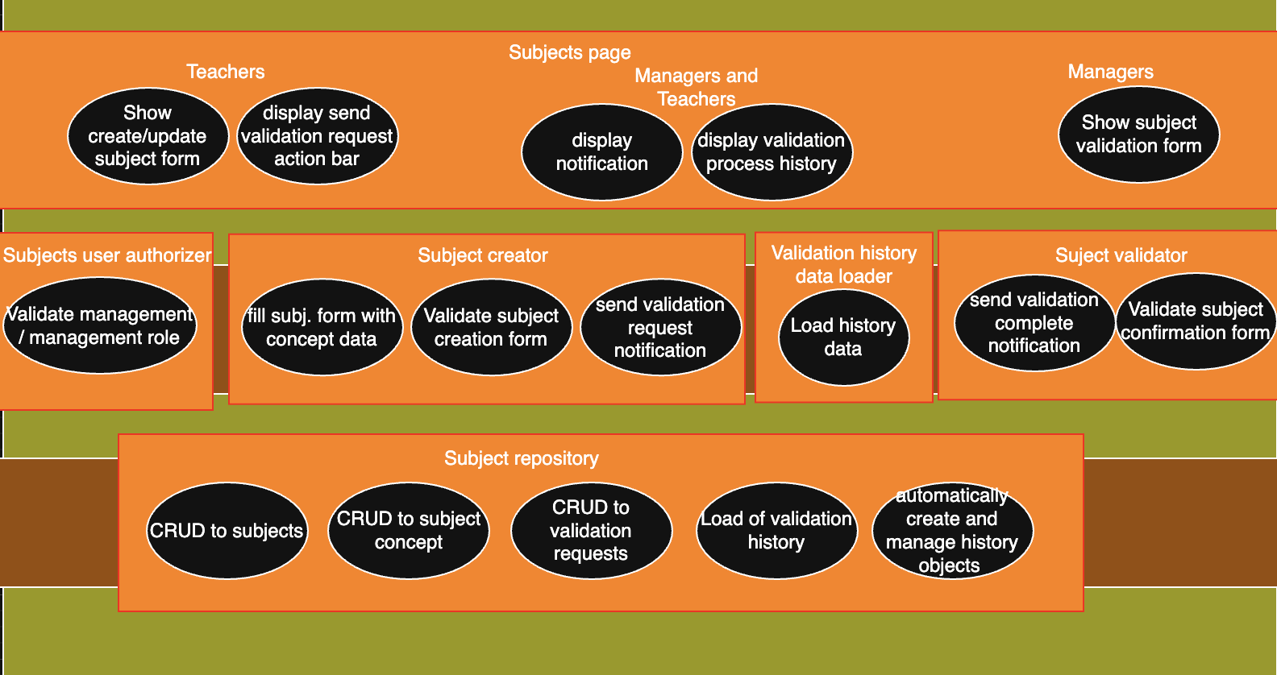
Creating and Validating Subjects
Everyone

Slide 9
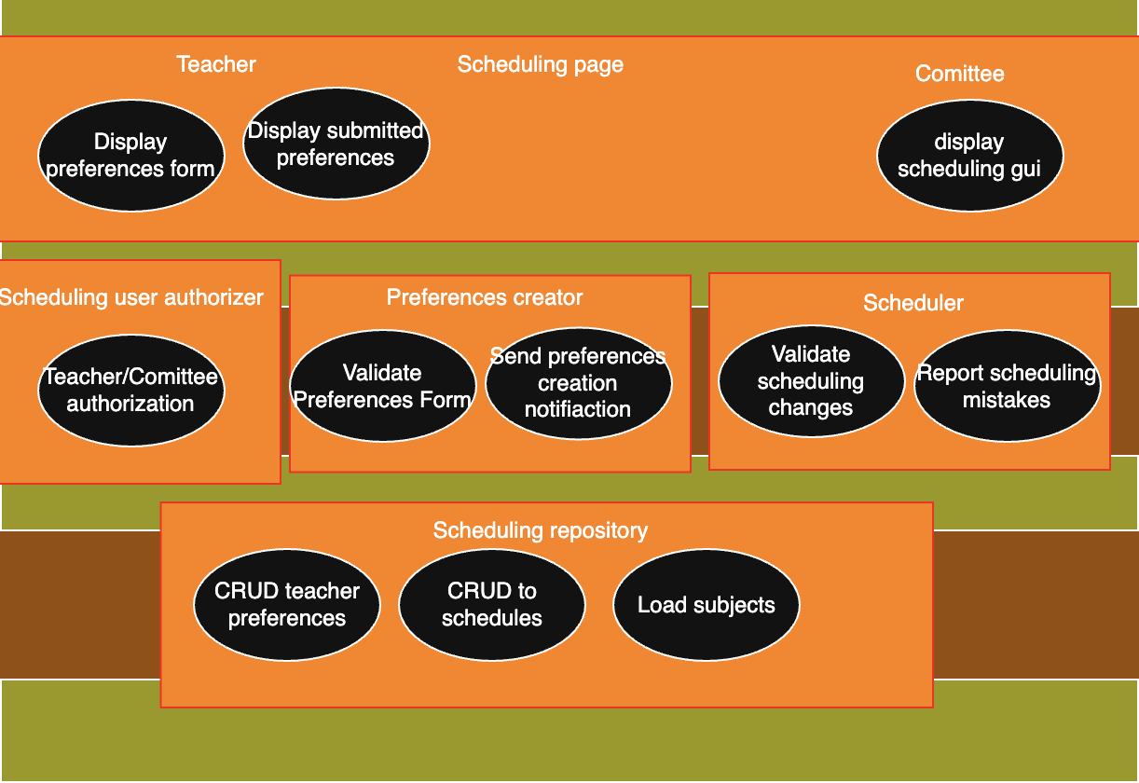
Scheduling classes
Everyone

Slide 10
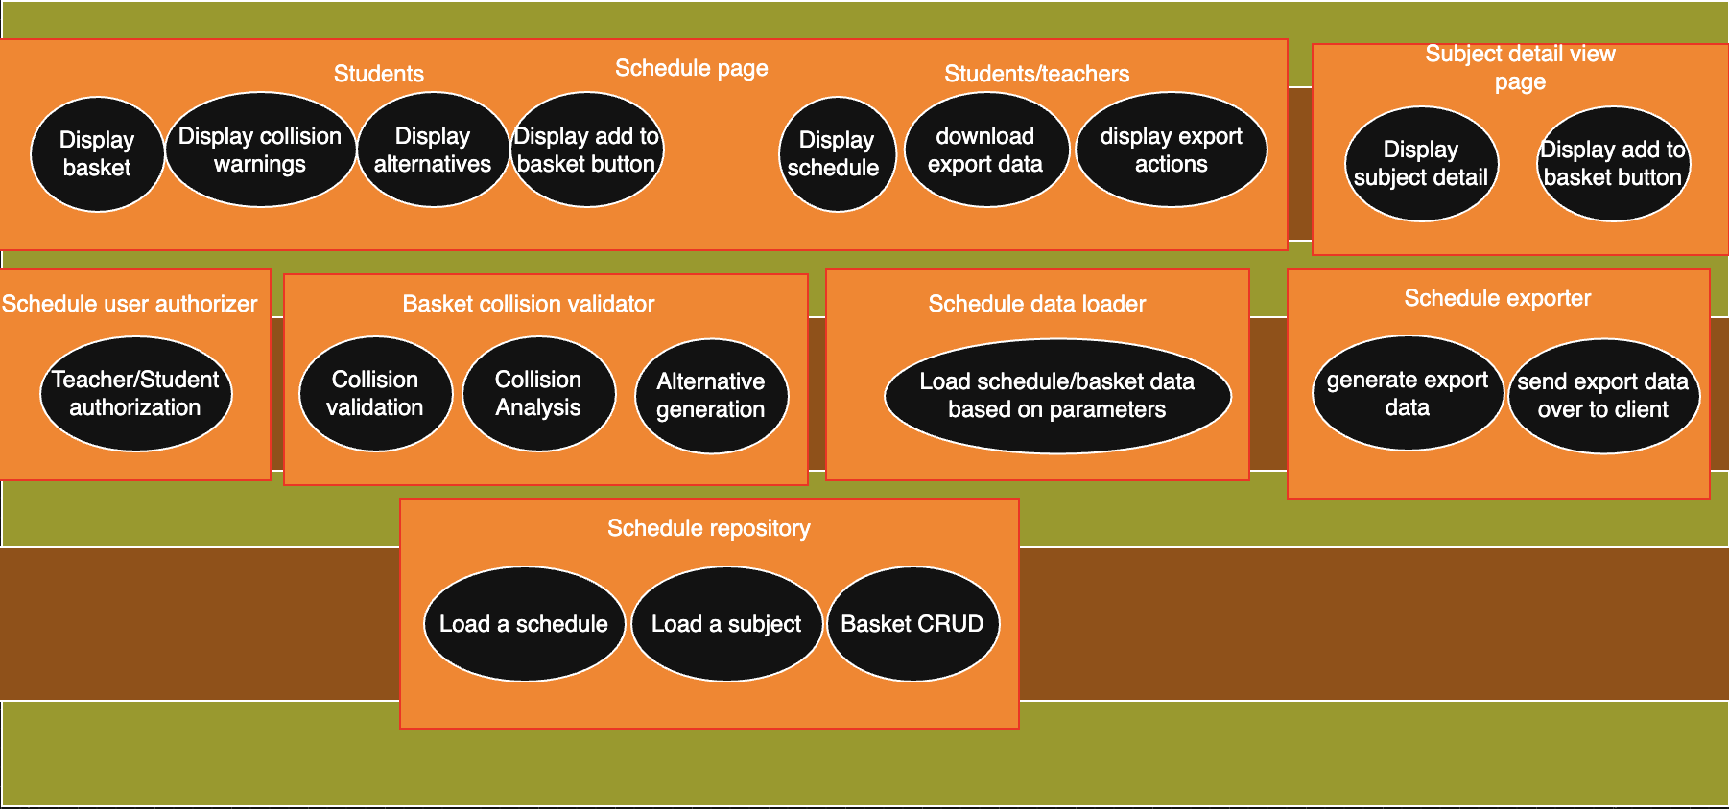
Access to Schedules
Everyone

Slide 11
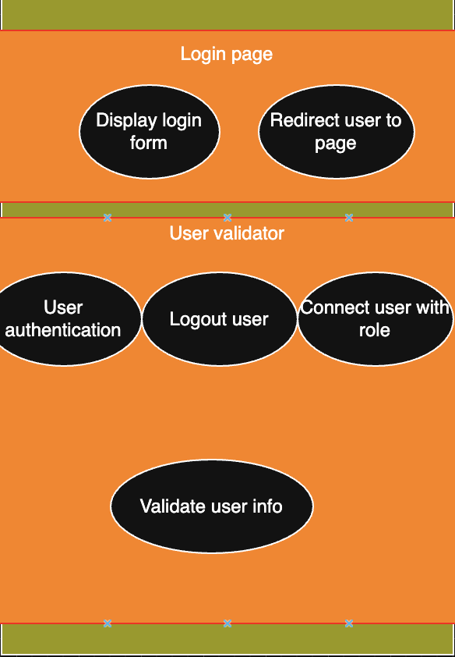
User Validation
Everyone

Slide 12
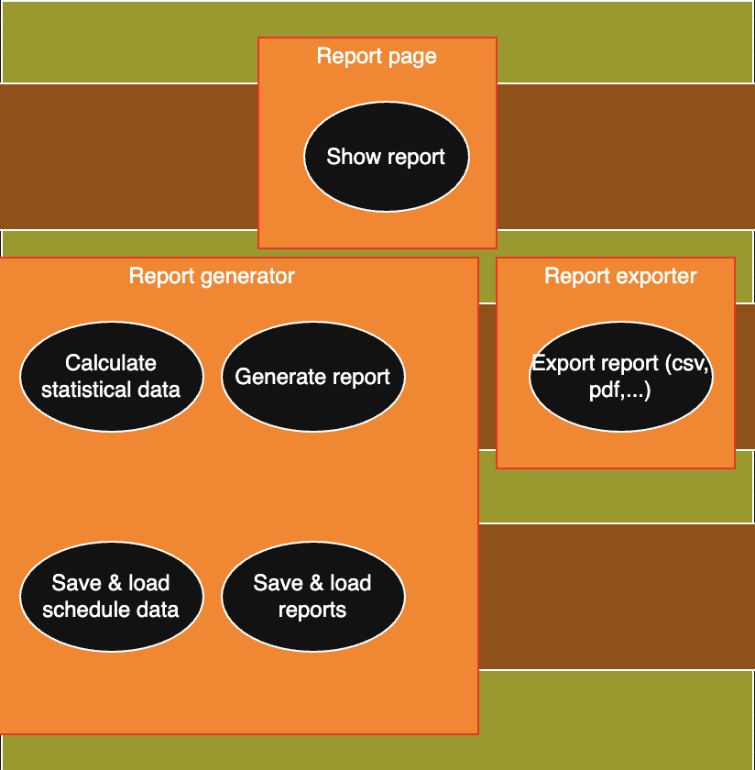
Statistical reporting
Everyone

Slide 13
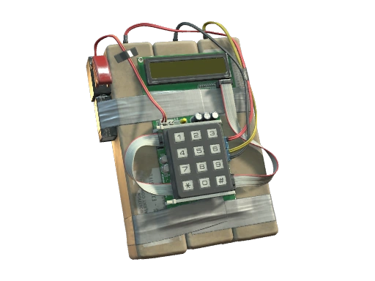

Slide 14
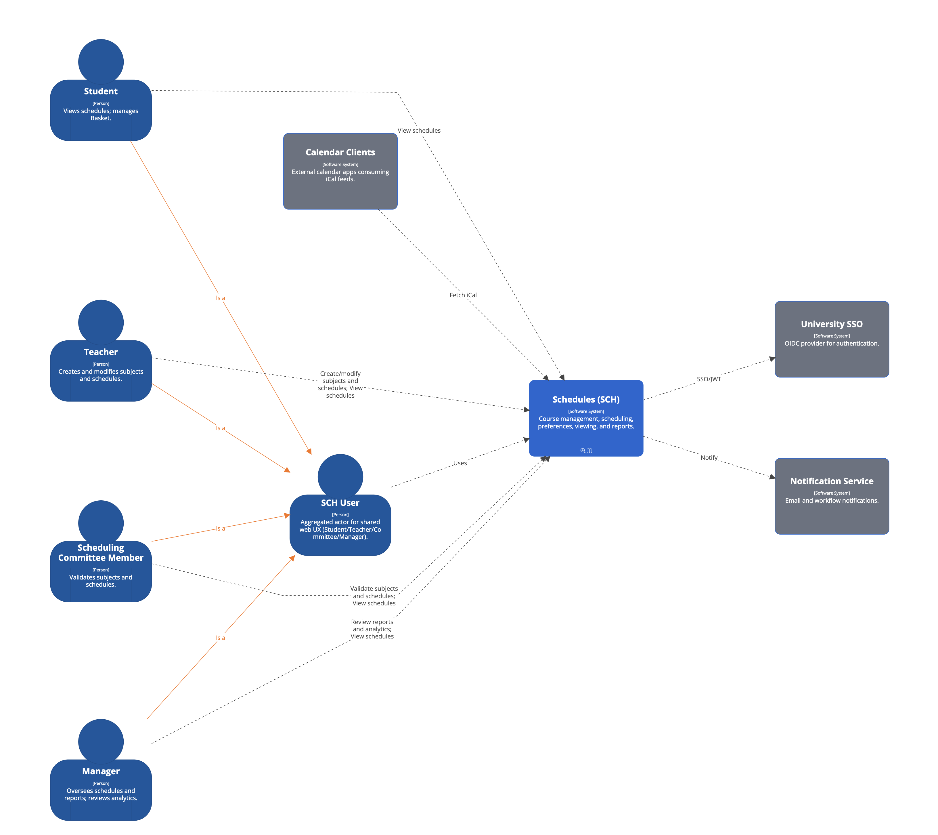
Faustus, Turčan

Slide 15
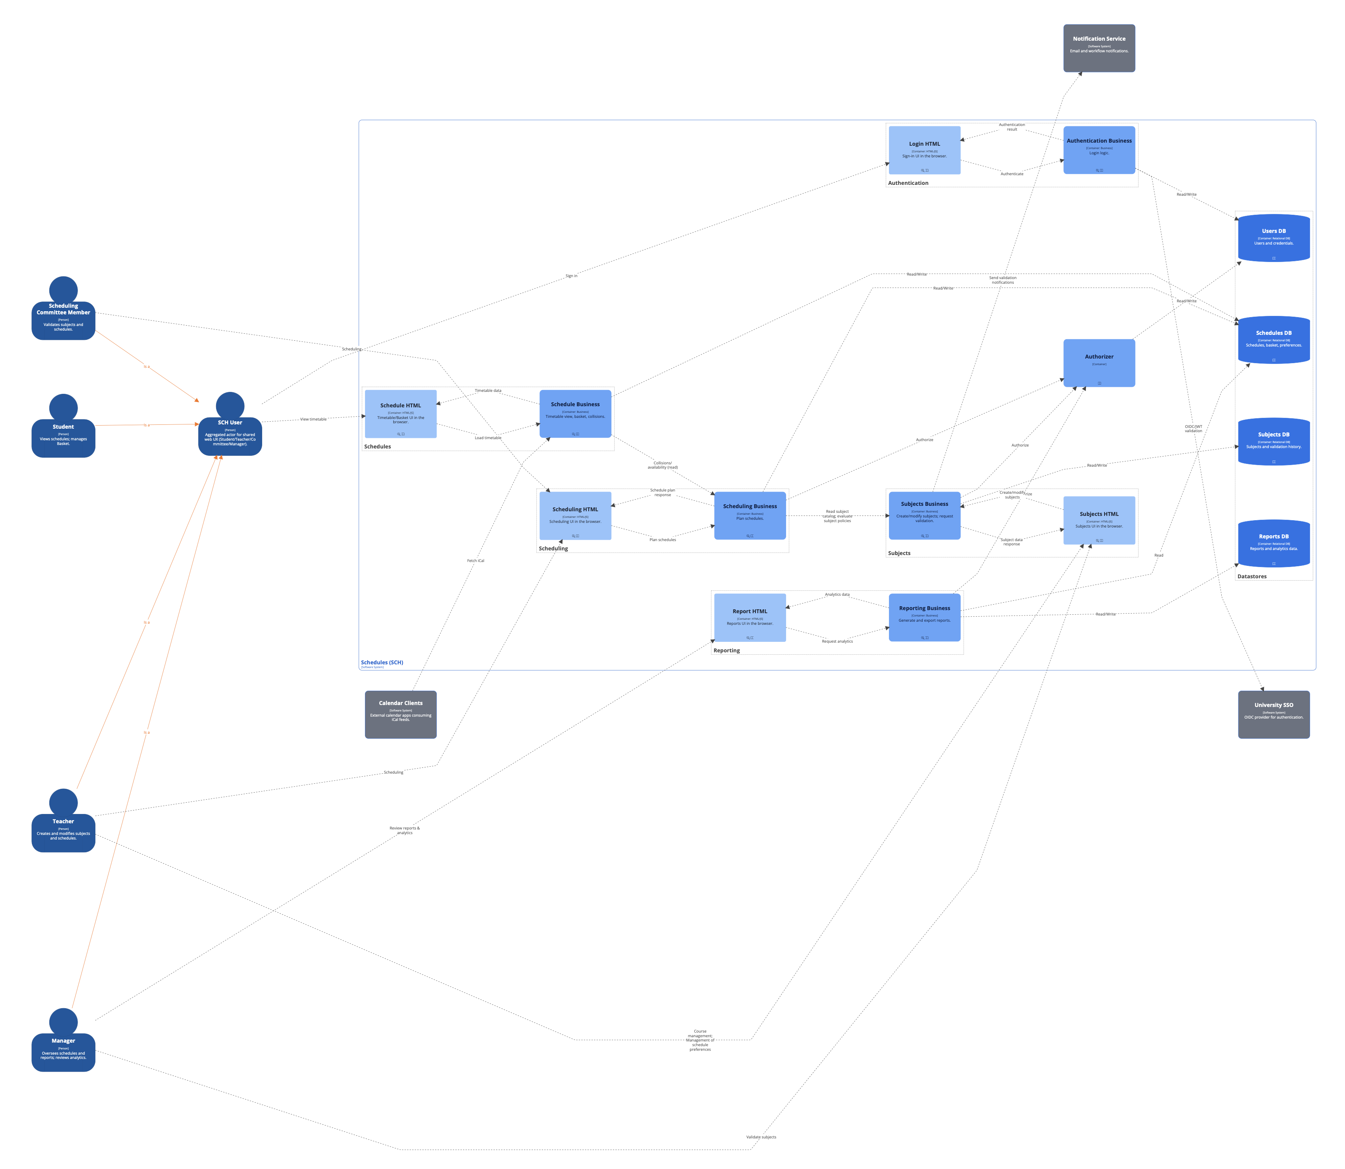
Turčan, Faustus

Slide 17
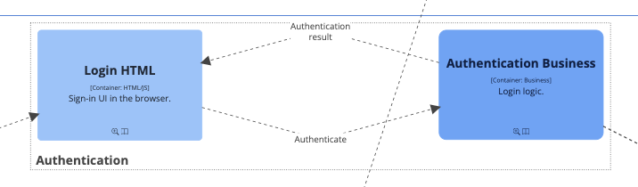
User
Users DB,
University SSO

Slide 19
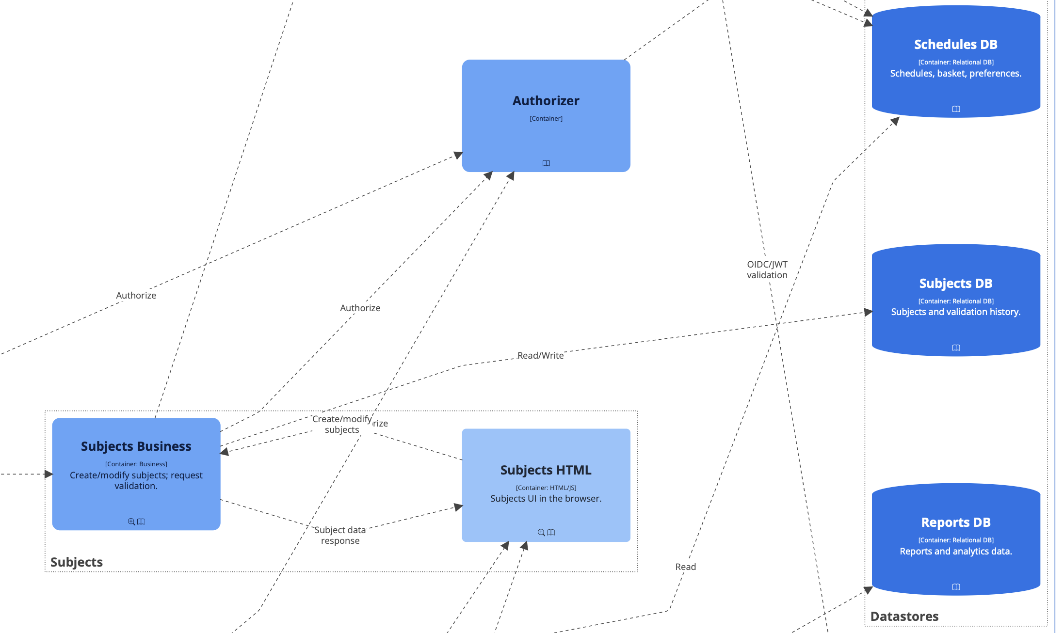
Notification service
Teacher and manager

Slide 21
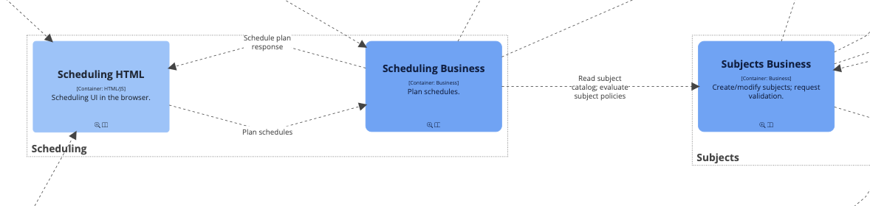
Schedule DB
Scheduling comittee
Auth.
Teacher

Slide 23
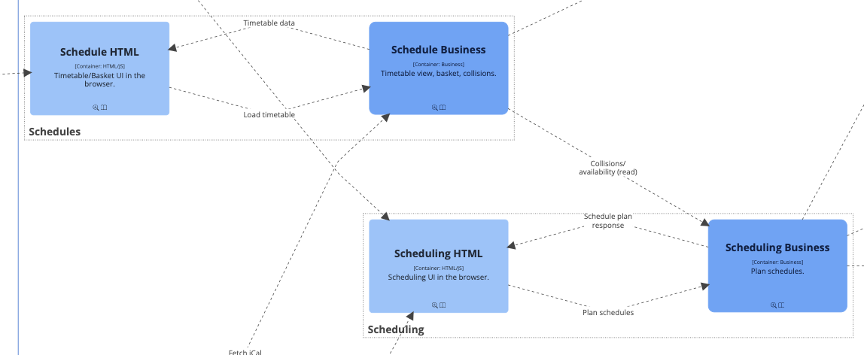
Schedule DB
user
Calendar clients

Slide 25
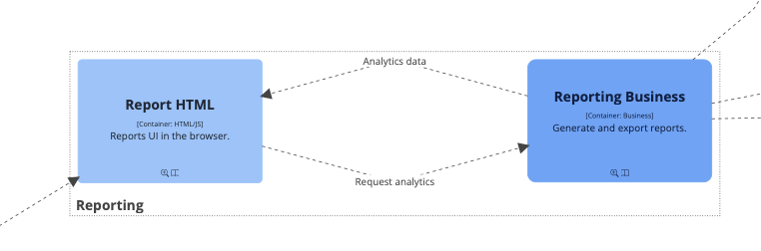
Auth.
Schedules DB
Reports DB
Manager

Slide 26
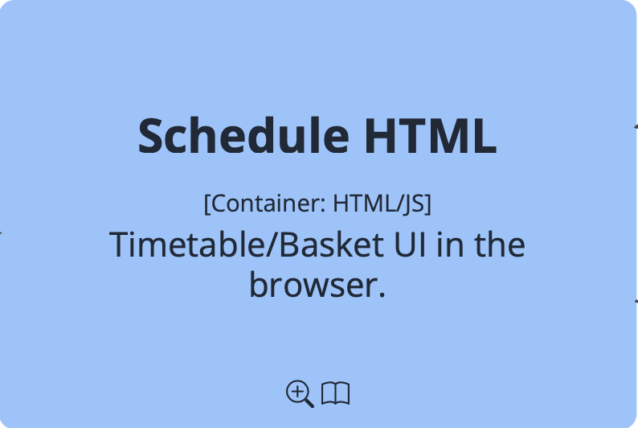

Slide 27
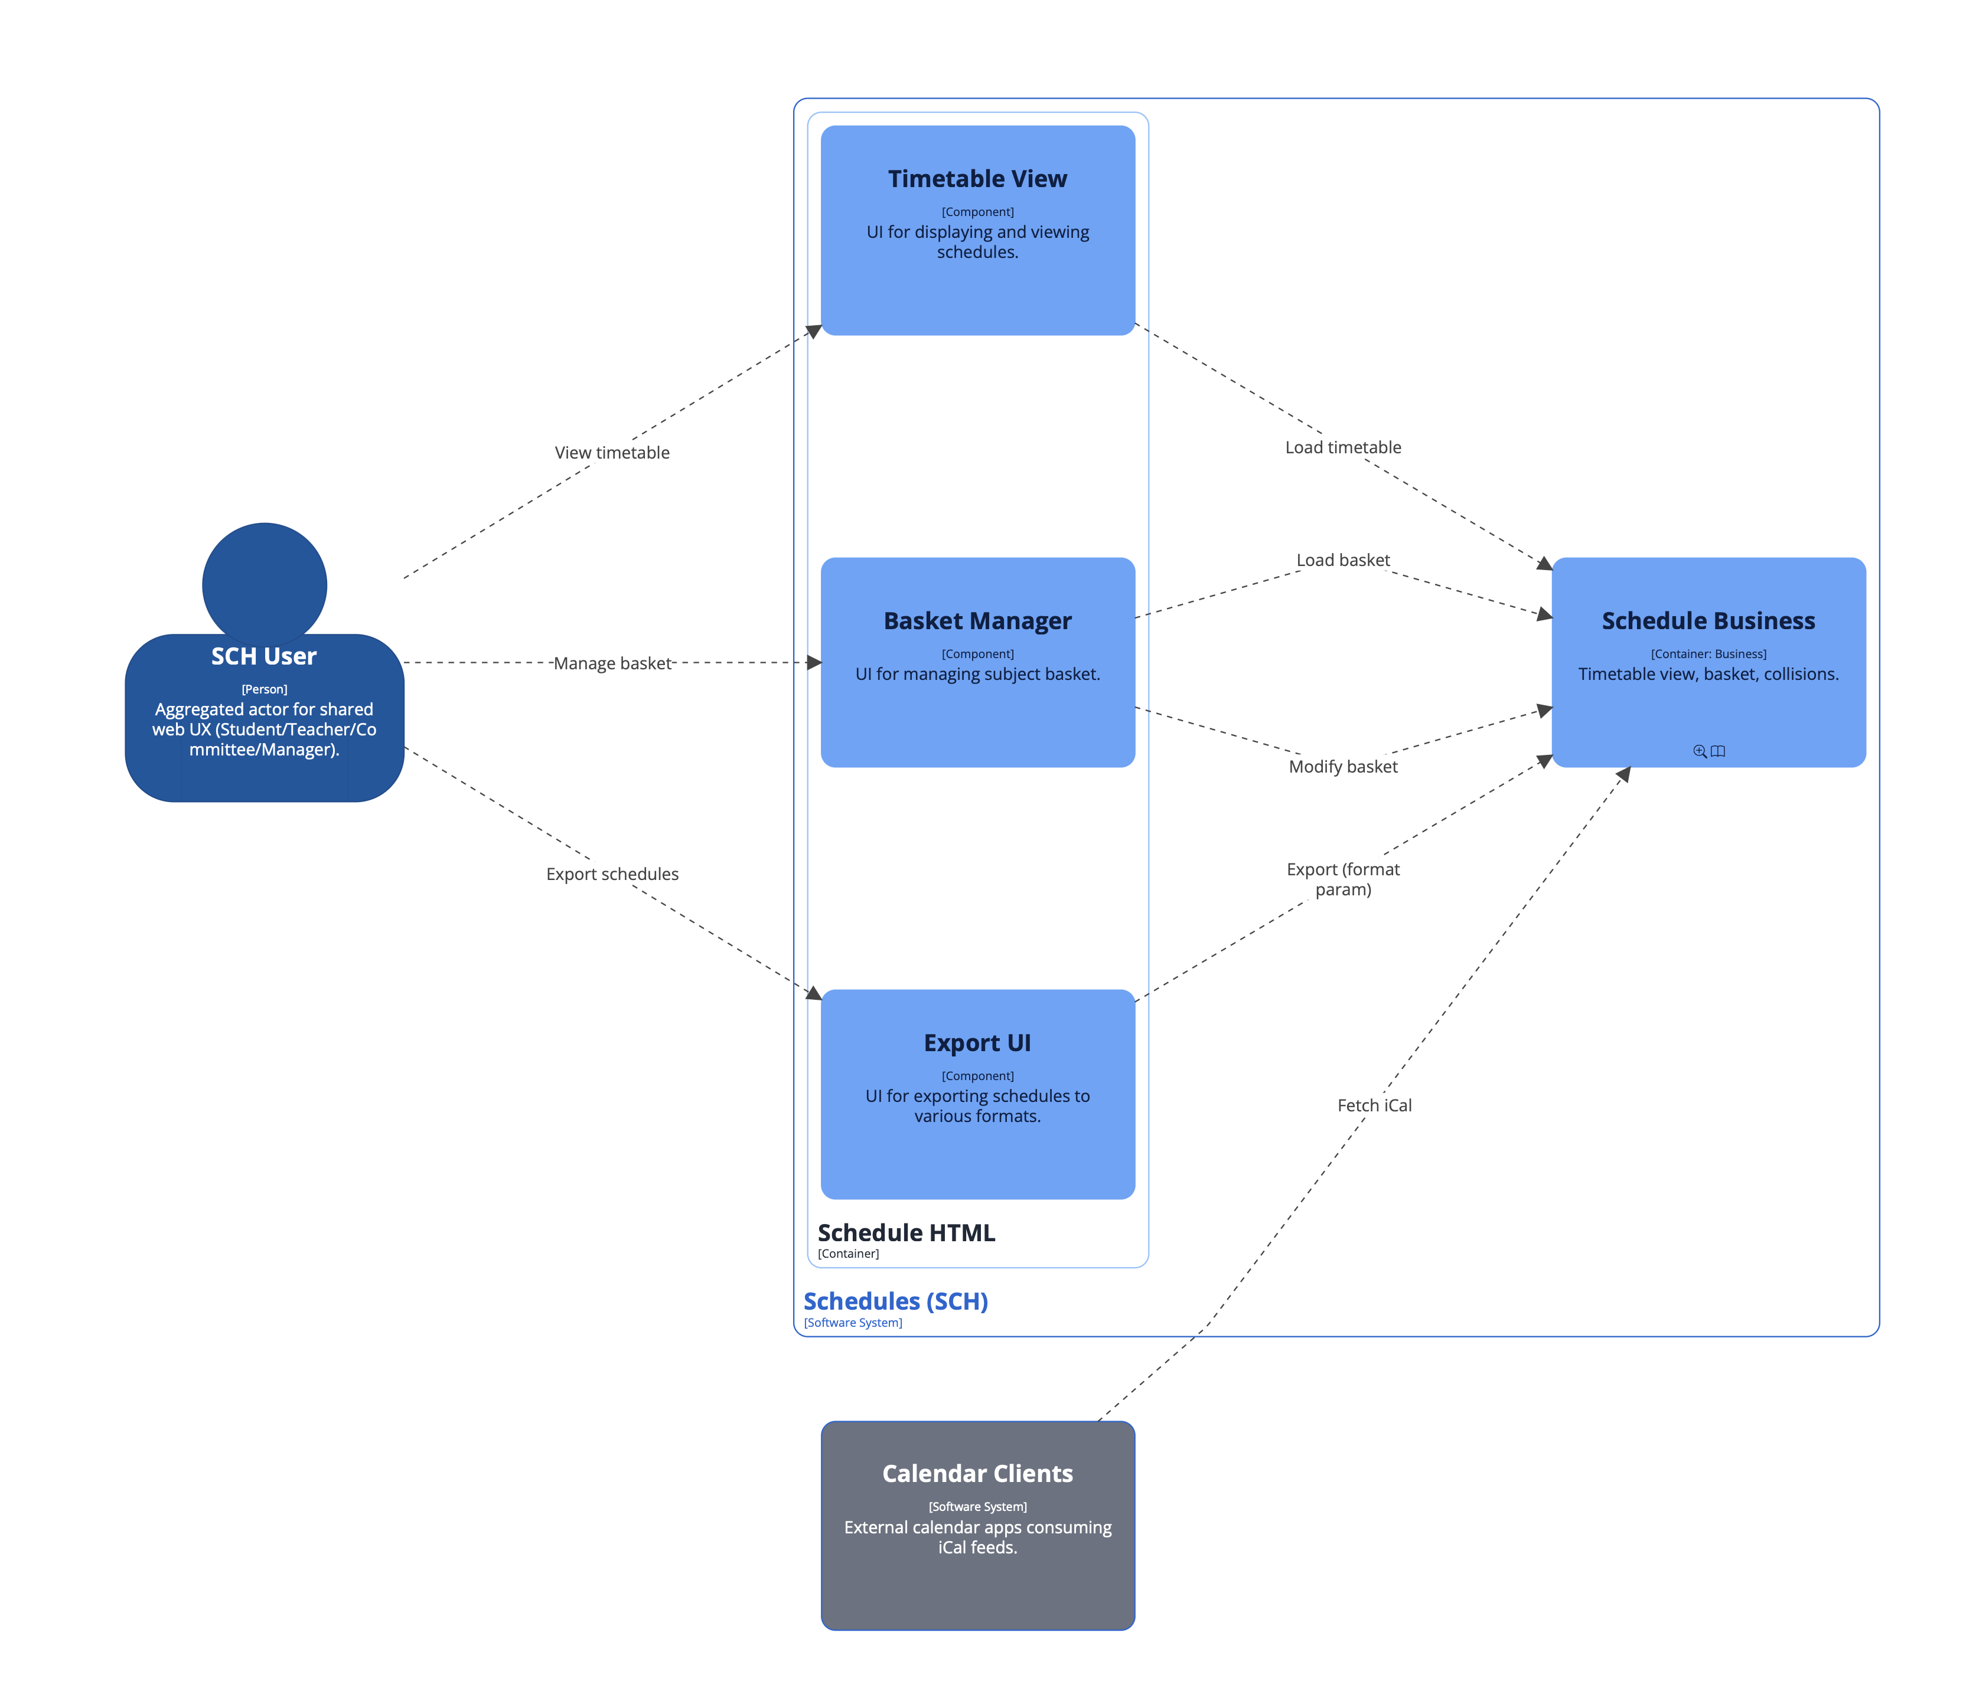
Faustus

Slide 28
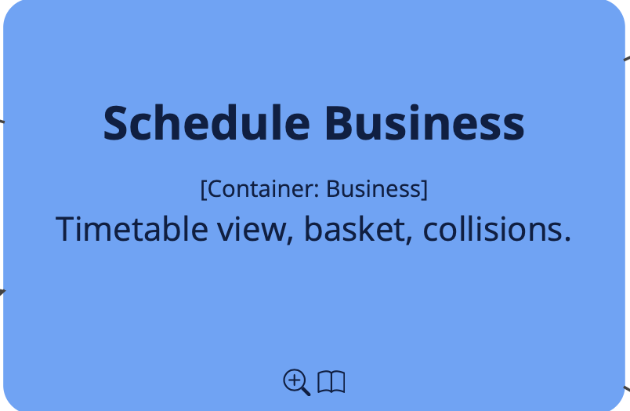

Slide 29
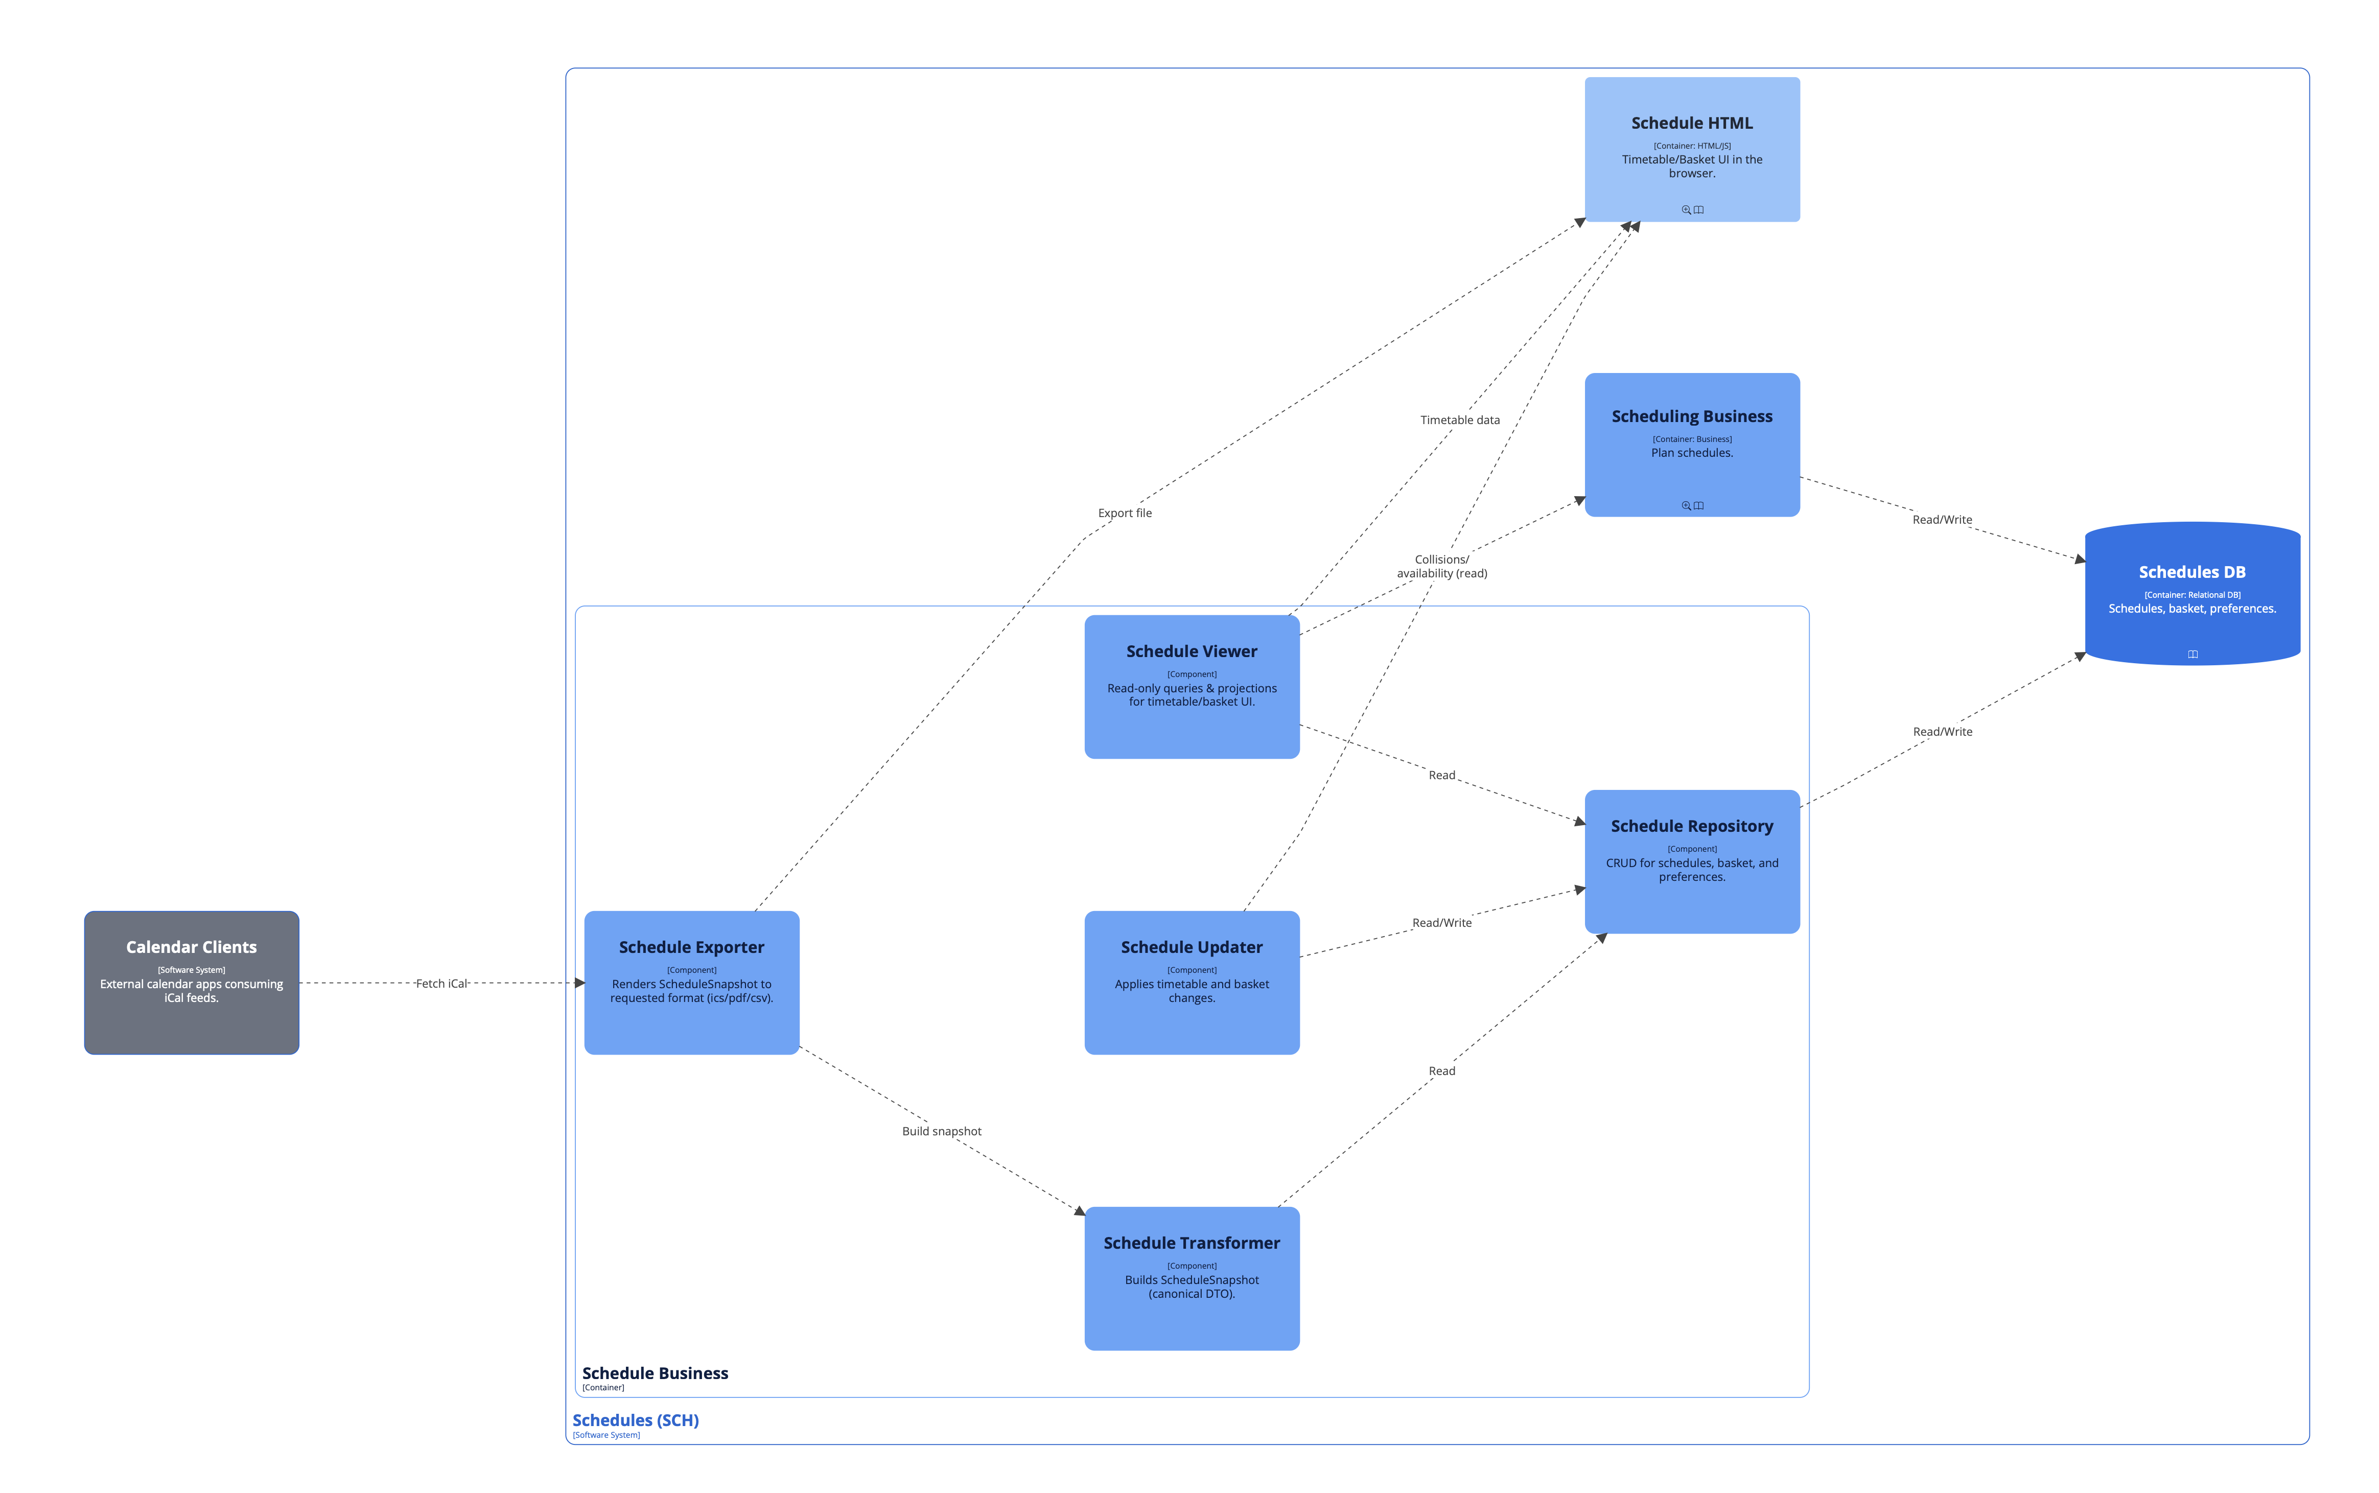
Faustus, Turčan, Toma

Slide 30
Dynamic diagram - View schedules (Student)

Slide 31
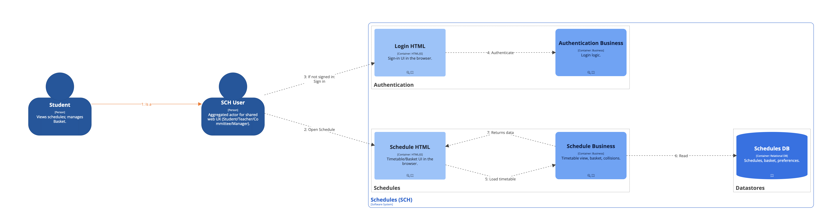
Toma

Slide 32
Deployment diagrams

Slide 33
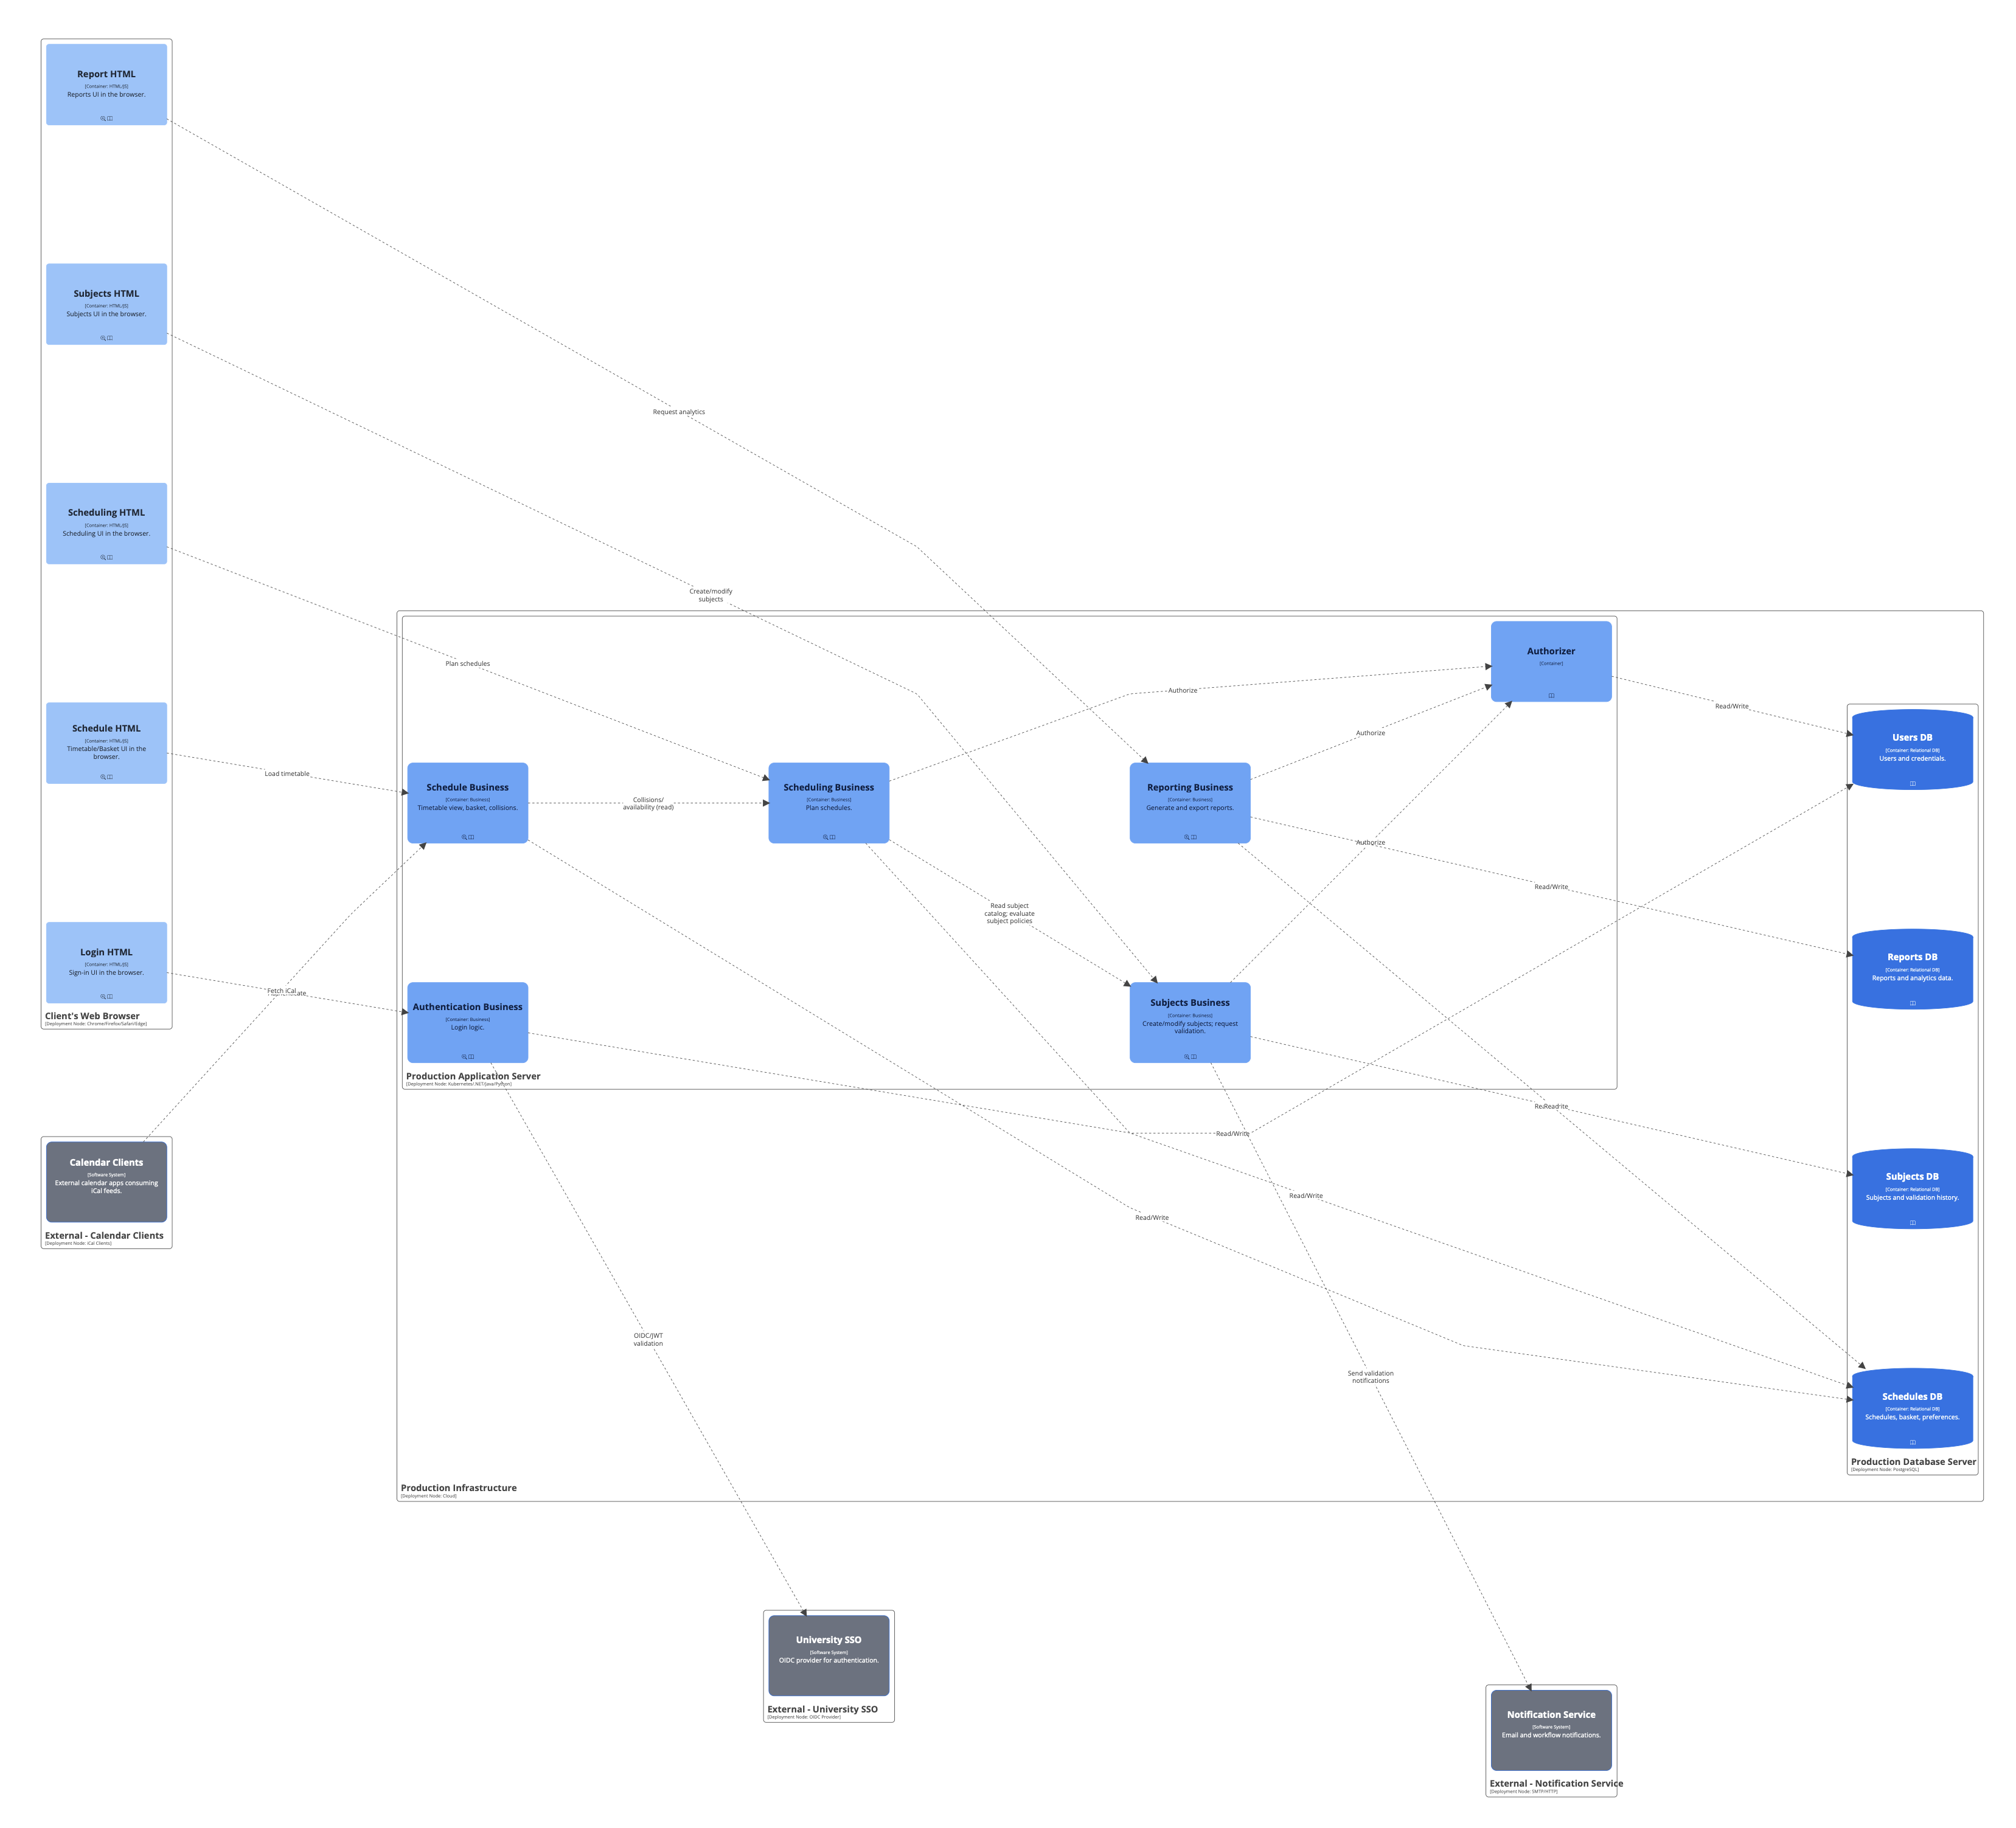
Toma, Helmich

Slide 34
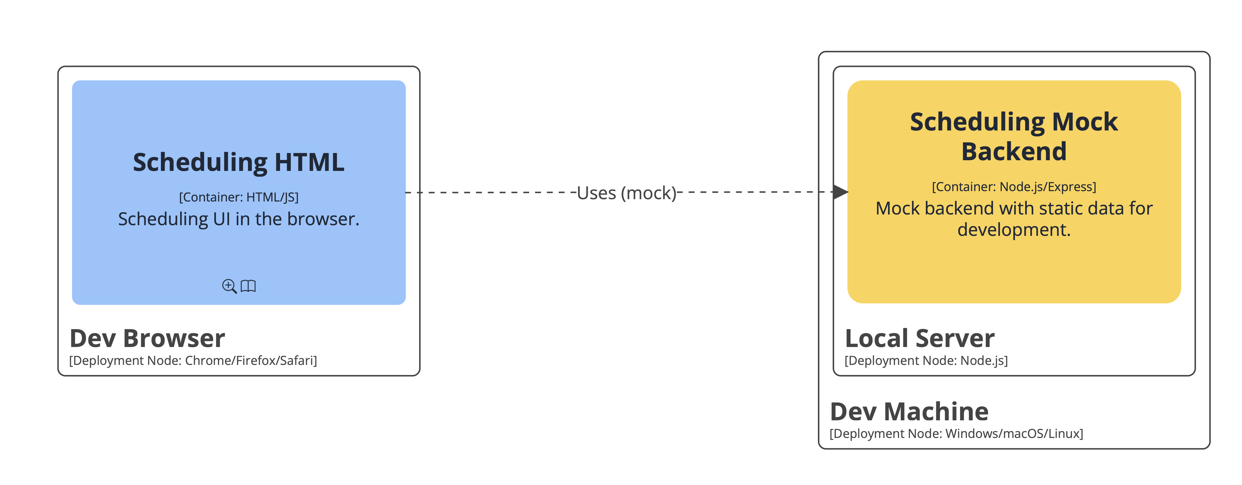
Helmich, Toma, Faustus

Slide 35
Questions?

